Slide 2
The I.C.E. Exchange is the premier event that connects, inspires, and provides valuable education for credentialing professionals so they can innovate, solve problems, impact change, and grow their programs and services.

Slide 3
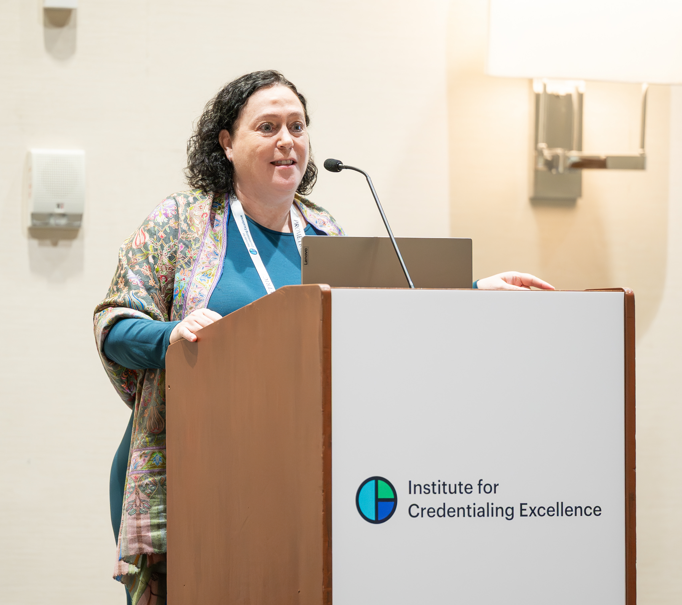
Session Name
Date and Time

Slide 4
Instructions
Update text on slides using the indicated colors and fonts.
Do not remove or add logos.
Do not add additional colors.
To access slides as images, hit save as, change format to jpg or png. When prompted, select “all slides” or “current slide” to save as an image.
Do not resize the images, as this can make the text appear blurry.

Slide 5
I am presenting at the I.CE. Exchange
Headshot goes here

Slide 6
Connect with I.C.E.
When posting on social media, we encourage you to tag I.C.E.’s social media pages and use the event hashtag to help amplify your participation and connect with fellow attendees.
Tag us on LinkedIn: Institute for Credentialing Excellence
Event Hashtag: #EXG2026

Slide 7
General Social Media Tips
Be authentic: Use a professional but approachable voice that reflects your expertise and perspective.
Stay timely: Share relevant industry news, trends, and updates from I.C.E. when appropriate.
Use AI thoughtfully: AI tools can help brainstorm ideas, draft posts, or summarize key takeaways, but always review content to ensure it reflects your voice and expertise.
Engage with others: Repost valuable content, join conversations, and give credit by tagging individuals, speakers, or organizations.
Use hashtags strategically: Hashtags help expand visibility and make your content easier to discover. Consider using tags like #Credentialing and #EXG2026.
Keep your profile updated: A complete and public professional profile makes it easier for attendees and industry peers to connect with you.

